Slide 1



Towards a Vocabulary for Incorporating Predictive Models into the Linked Data Web
Evangelos Kalampokis, Areti Karamanou, Efthimios Tambouris, Konstantinos Tarabanis

Slide 2
Objective
“To propose an RDF Schema vocabulary, named the Linked Statistical Models (limo) vocabulary, that will enable the incorporation of descriptions of predictive models into the Linked Data Web and establish links to other resources such as datasets, other models, academic articles and studies.”

Slide 3
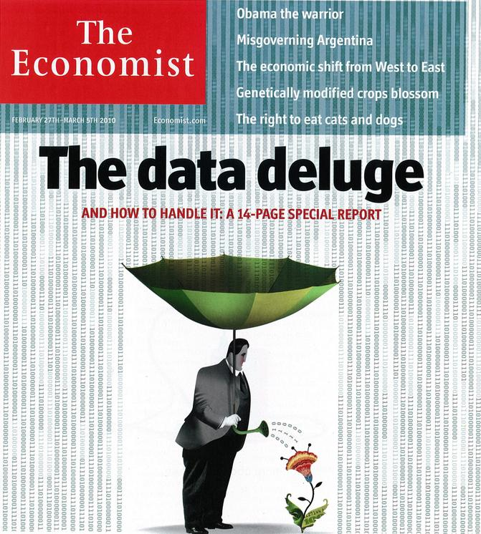

Slide 4

Data analytics
Easy access to large amounts of data
Combine data and perform data analytics
Create statistical or data mining models for understanding and describing various problem areas and domains
http://www.flickr.com/photos/seandreilinger/2587606107

Slide 5




E. Kalampokis, E. Tambouris and K. Tarabanis (2013) Linked Open Government Data Analytics, M.A. Wimmer, M. Janssen, and H.J. Scholl (Eds.): EGOV 2013, LNCS 8074, pp. 99-110. IFIP International Federation for Information Processing.

Slide 6
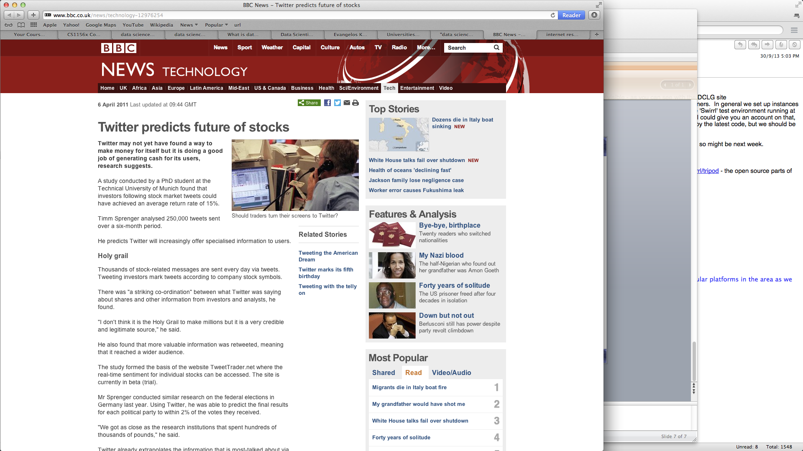
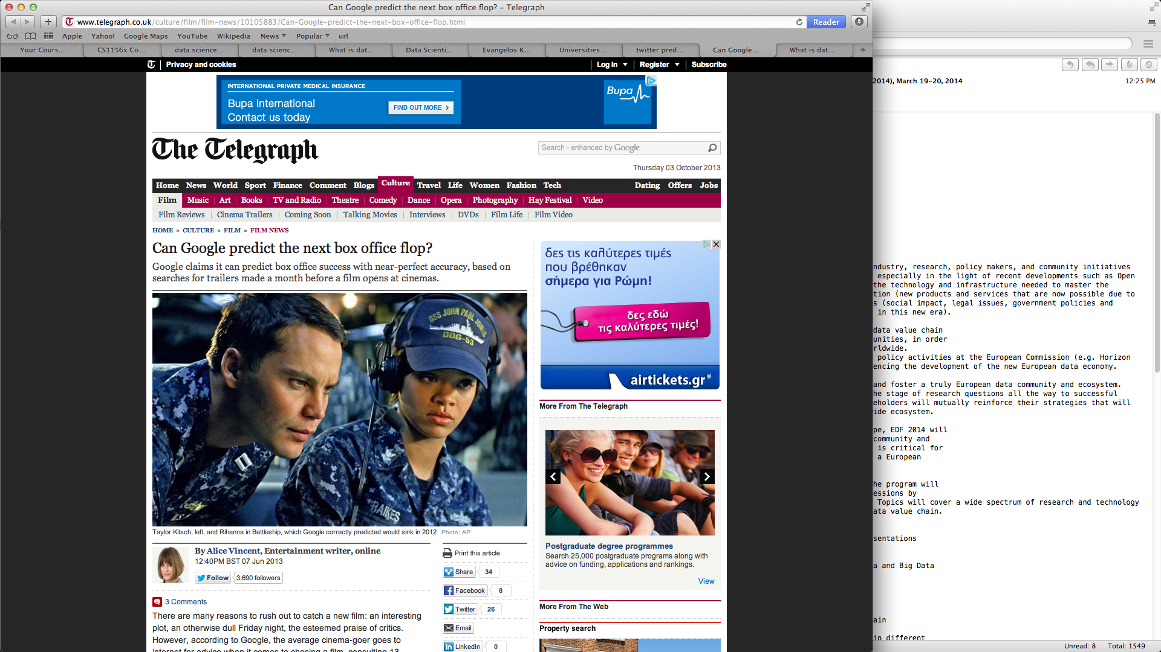
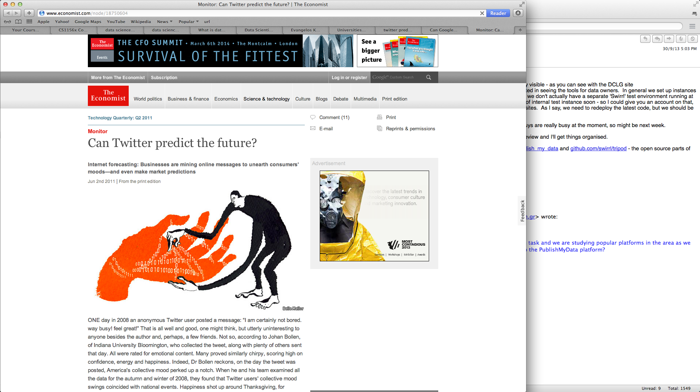

Slide 7
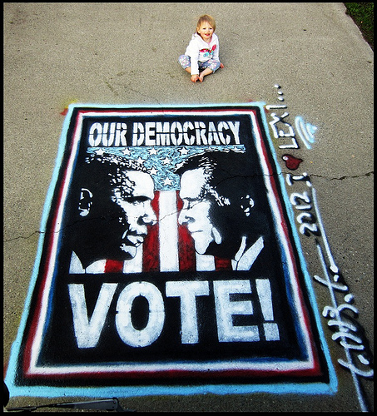
Controversial results
11 models aiming at predicting elections results using Social Media (SM) related variables
Only 3 of them included sentiment related variables
Only 1 of them employed predictive analytics evaluation methods
6 supported SM predictive power while 5 challenged it
http://www.flickr.com/photos/tonythemisfit/3023871670/
http://www.flickr.com/photos/cainandtoddbenson/7175209704
E. Kalampokis, E. Tambouris and K. Tarabanis (2013) Understanding the Predictive Power of Social Media, Internet Research, Vol.23, No.5, pp. 544-559

Slide 8
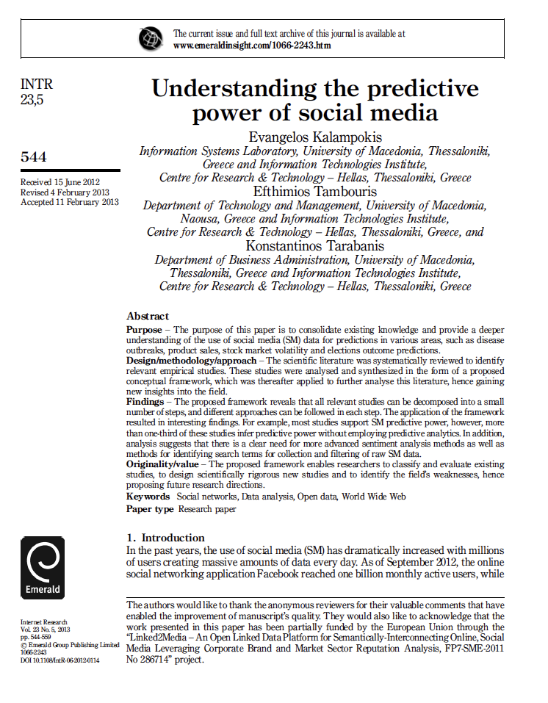

Understanding the predictive power of SM
52 empirical studies that exploit Social Media for predictions
The predictive power of a model is directly related to:
Selected predictors
Statistical or data mining method used
Evaluation method employed
Datasets selected
Approaches used to collect, filter and process data
E. Kalampokis, E. Tambouris and K. Tarabanis (2013) Understanding the Predictive Power of Social Media, Internet Research, Vol.23, No.5, pp. 544-559

Slide 9

Why don’t we reuse all this information?
http://www.flickr.com/photos/pagedooley/8435953365

Slide 10
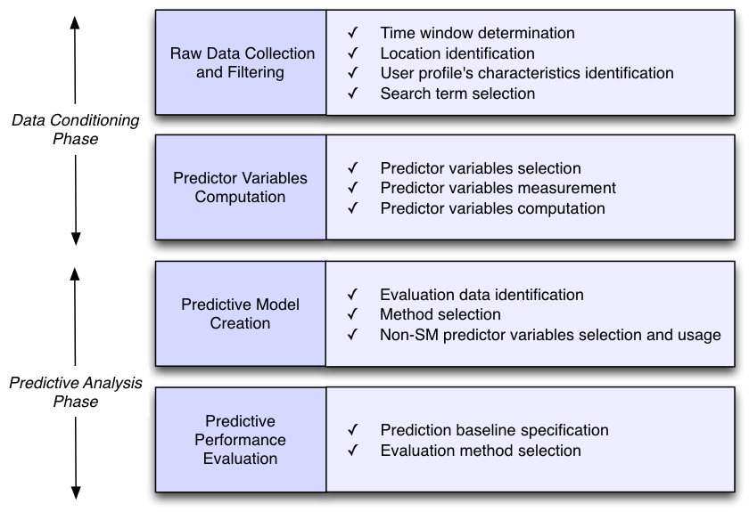
Social Media Data Analysis Process for Predictive Analytics
E. Kalampokis, E. Tambouris and K. Tarabanis (2013) Understanding the Predictive Power of Social Media, Internet Research, Vol.23, No.5, pp. 544-559

Slide 11
Reuse of Descriptions of Predictive Models
Discover variables that a predictive relationship between them have been suggested by a model
Discover predictor variables that are connected to the same response
Discover statistical or data mining methods used in certain cases
Discover datasets used or could be reused in existing or new models
Discover predictive models that could be reused (e.g. for baseline predictions or with different data)
This is where Linked Data comes in …

Slide 12


Predictive Models
http://www.flickr.com/photos/mbiskoping/6075387388

Slide 13
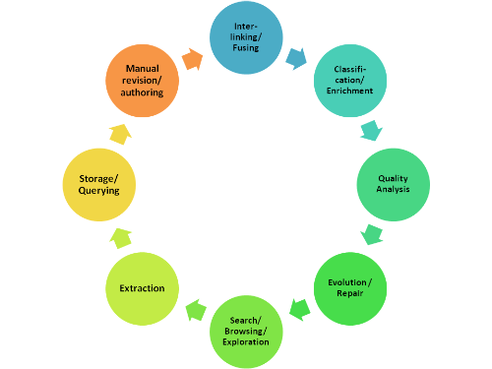
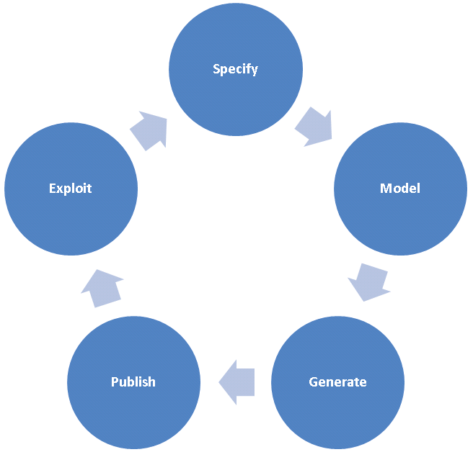
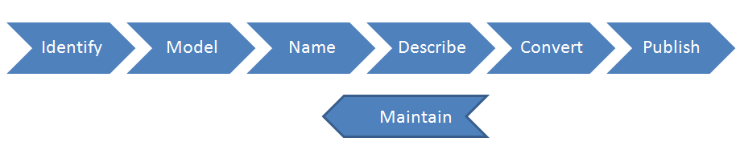
A vocabulary for describing predictive models as Linked Data
A simple vocabulary that enables the creation of description of predictive models based on linked data principles

Slide 14


Relevant endeavors - PMML
The Predictive Model Markup Language (PMML) is a standard for XML documents which express trained instances of analytic models
Main goal: cross-platform interoperability
PMML contains over 700 elements

Slide 15
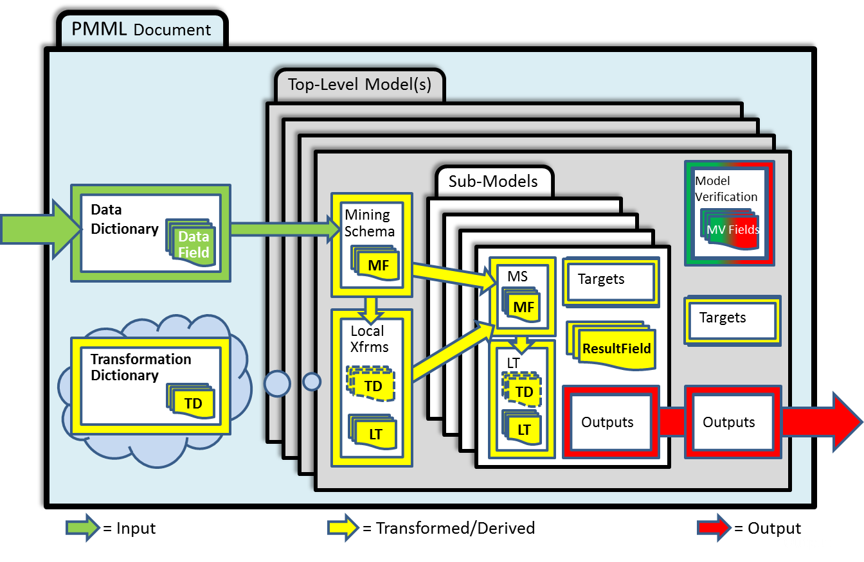

Slide 16
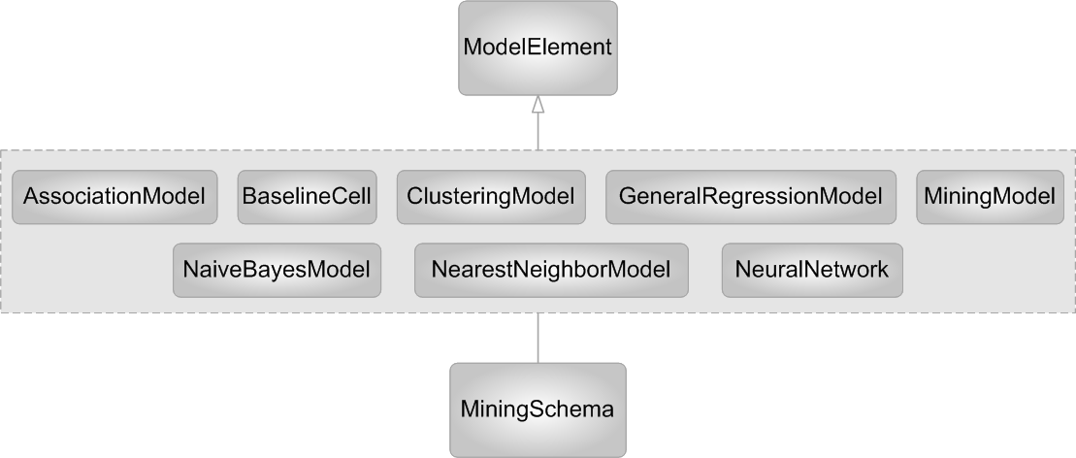
PMML’s Model Element

Slide 17
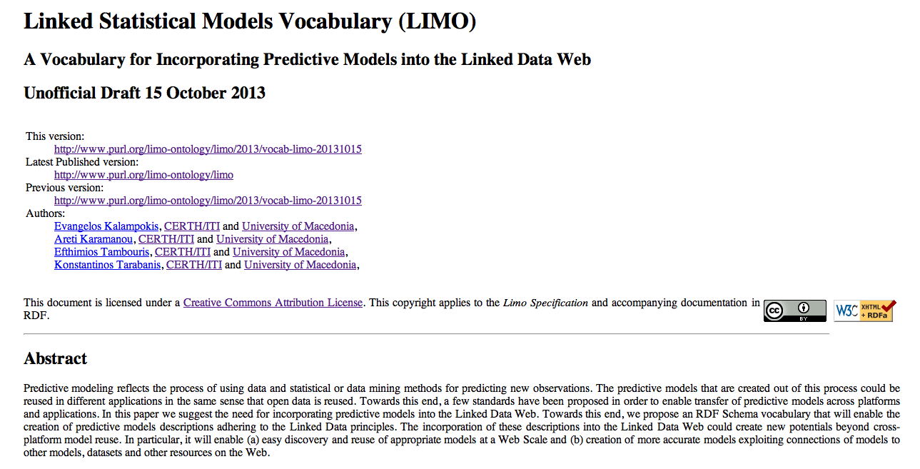
Linked Statistical Models Vocabulary (LIMO)
LIMO will enable the creation of predictive models descriptions adhering to the Linked Data principles
First unofficial draft in:
http://www.purl.org/limo-ontology/limo

Slide 18
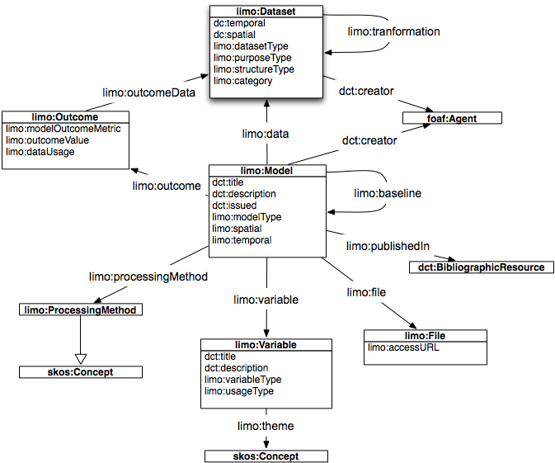
http://purl.org/limo-ontology/limo

Slide 19
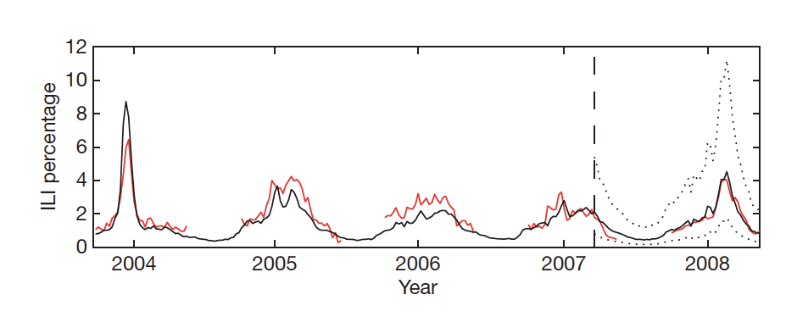


Ginsberg, J., Mohebbi, M. H., Patel, R. S., Brammer, L., Smolinski, M. S., Brilliant, L.: Detecting inuenza epidemics using search engine query data. Nature, 457(7232), 1012{4 (2009)

Slide 20
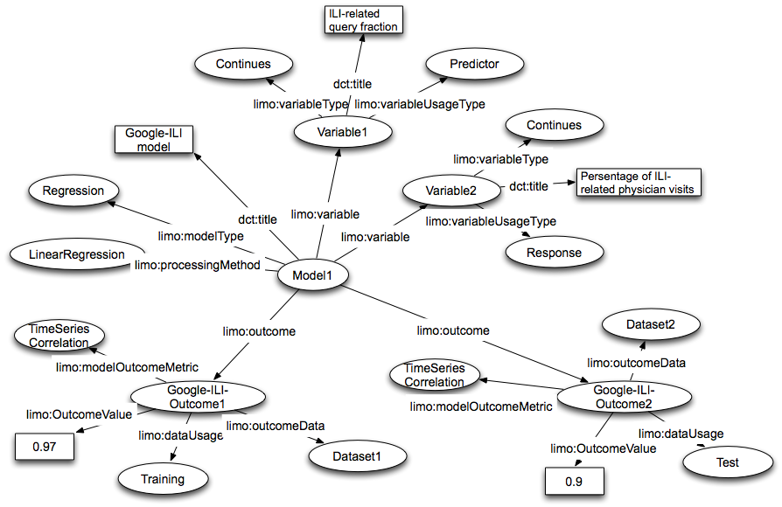

Slide 21
Future Work
Finalize the model
Create a dataset with predictive models described using LIMO
Develop LIMO descriptions exporter

Slide 22

Future Work
OpenCube: Publishing and Enriching Linked Open Statistical Data for the Development of Data Analytics and Enhanced Visualization Services
FP7-ICT-2013-SME-DCA No 611667
Start date: 1 November 2013
Duration: 24 months
http://www.flickr.com/photos/stuckincustoms/524185543

Slide 24

Thank you for your attention!!
http://kalampok.is

